Slide 1
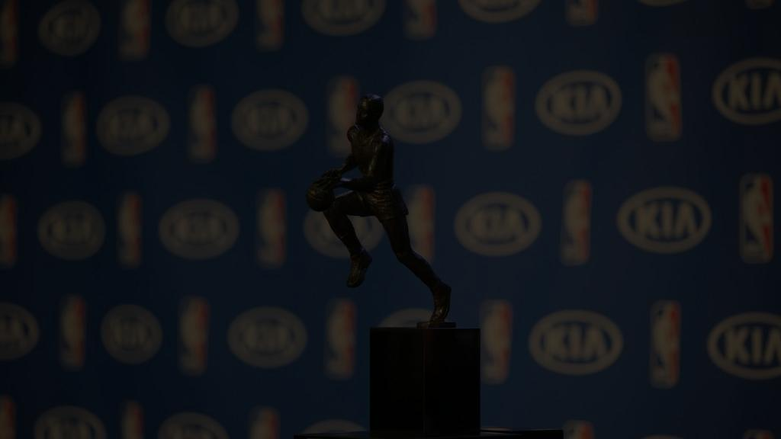
Predicting NBA MVP using Machine Learning
Jacob Schuh & Bryan Bui

Slide 2
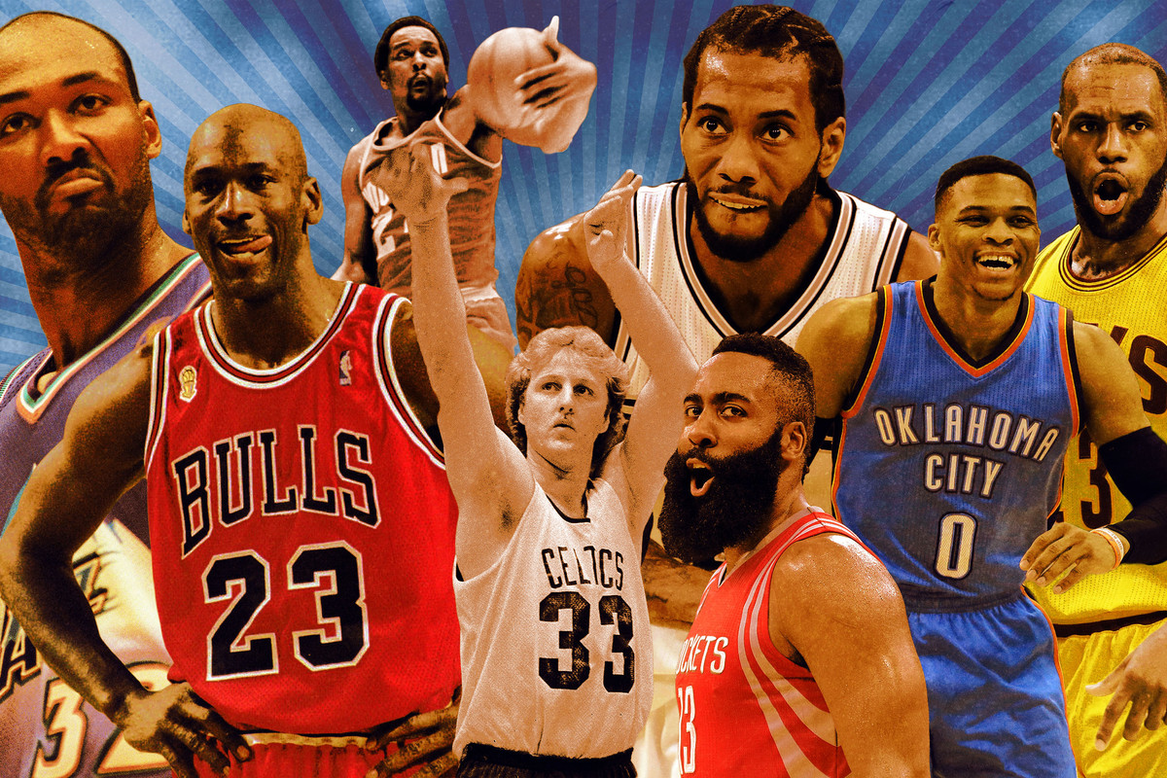
Introduction
Our project will be analyzing data from the past 20 seasons of MVP finalists create a model to help predict the MVP of a season, using both regression models and classification models.

Slide 3
Introduction
In the NBA (National Basketball Association), each year a player is named the MVP (most valuable player). This is awarded to the “best” player based on the number of votes a player receives from qualified figures in the basketball media.
Winning an MVP has very big implications for both the individual player, and the large betting market surrounding the NBA MVP.

Slide 4
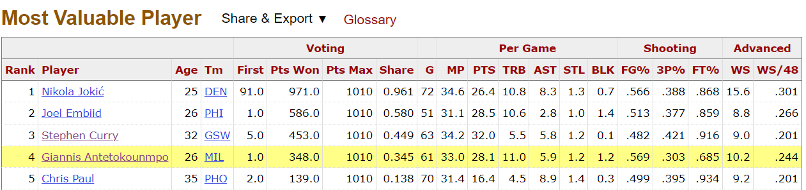
Data
Data for this project was obtained from https://www.basketball-reference.com/ . Statistics from each player receiving at least one MVP vote from 2002-2022 was used in our analysis. 275 players were randomly partitioned into 70/30 training and testing split and before the regression models was normalized.

Slide 5
Data
We will use the following variables to create a model predicting the NBA MVP award share of a player:
Age
Games Played
Minutes Played
Points Per Game
Rebounds Per Game
Assists Per Game
Steals Per Game
Blocks Per Game
Field Goal Percentage
Three Point Percentage
Free Throw Percentage
Win Shares
Win Shares Per 48 Minutes
Team Wins

Slide 6
Methods
We will be using various machine learning techniques in order to find the best model.
Regression
Neural Network
Support Vector machine
Linear Regression
Target Variable: Voting Shares
Classification
K-Nearest Neighbors
Decision Trees.
Target Variable: MVP

Slide 7
Results of Default Methods for Regression
Methods | R (Training) | R² (Training) | R (Testing) | R² (Testing)
Neural Network | 0.8262 | 0.6826 | 0.7854 | 0.6169
SVM | 0.8669 | 0.7514 | 0.7689 | 0.5912
Linear Regression | 0.7136 | 0.5092584 | 0.7496 | 0.56189

Slide 8
Results of Default Methods for Classification
Methods | Accuracy (Training) | Accuracy (Testing)
Decision Tree* | .99 | 0.92
KNN | 0.8645833 | 0.8928571

Slide 9
New Parameters
Neural Net: | hidden =1, threshold = 0.02, stepmax = 1e+05, rep = 2, 'sag'
SVM: | "radial", gamma = 1/55, cost = 1.1, epsilon = .065
Linear Regression: | PTS + AST + FT. + WS + WS.48 + TmWin
Decision Tree: | 10 trials
KNN: | k = 3

Slide 10
Results
Methods | R (Training) | R² (Training) | R (Testing) | R² (Testing)
Neural Network | 0.8169552 | 0.6674158 | 0.78967 | 0.6235787
SVM | 0.809822 | 0.6558117 | 0.7906128 | 0.6250686
Linear Regression | 0.6978674 | 0.4870189 | 0.7230049 | 0.5227361

Slide 11
Results
Methods | Accuracy (Training) | Accuracy (Testing)
Decision Tree* | .99 | 0.92
KNN | 0.9270833 | 0.9166667

Slide 12
Best Methods
SVM model and the Neural Network model were virtually identical in results with training/testing accuracy of (80.98%/79.06%) and (81.70%/78.97%) respectively.
Between the Decision Tree and the KNN models, there is also very little difference, although the Decision Tree is just slightly more accurate with a training testing accuracy of (99%,92%), compared to (92.7%, 91.7%) for KNN.

Slide 13
Predict current season mvp frontrunners
Player | Bref Prediction | Neural Net | SVM | Decision Tree*
Luka Doncic | 31.4% | 0.509922087 | 0.4168301031 | 0
Jayson Tatum | 21.3% | 0.390142269 | 0.2096586126 | 0
Nikola Jokic | 14.9% | 0.356394677 | 0.3013651908 | 0
Giannis Antetokounmpo | 11.8% | 0.138083521 | 0.1731540080 | 0
Stephen Curry | 8.0% | 0.247930989 | 0.2056136460 | 0
Donovan Mitchell | 3.6% | 0.009607278 | 0.0857364342 | 0
Tyrese Haliburton | 3.1% | -0.012754467 | -0.0005676882 | 0
Joel Embiid | 2.4% | -0.037888259 | 0.0806173312 | 0
Devin Booker | 1.8% | -0.023486251 | 0.0354720542 | 0
Domantas Sabonis | 1.8% | -0.039842135 | -0.0319469833 | 0

Slide 14
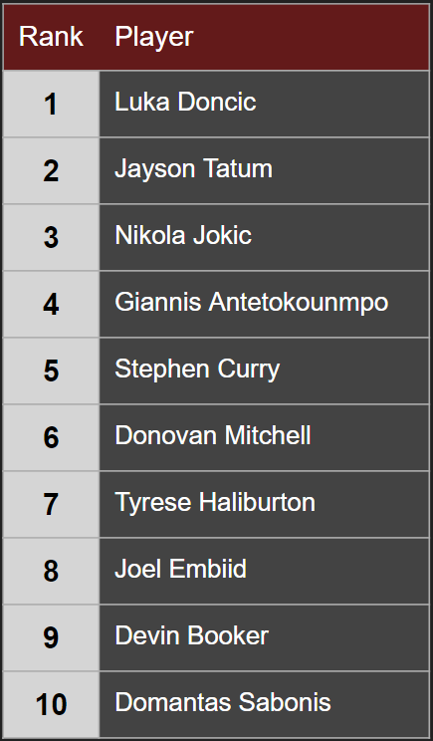
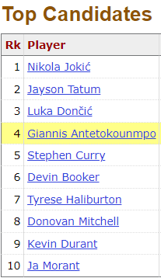
Comparing Results
Comparing our rankings to the rankings on https://www.basketball-reference.com/, which uses a model based previous voting results, our list had Luka Doncic winning the award based on the numbers so far this season instead of Nikola Jokić. Both lists had the same players in the top five voting positions though.

Slide 15
Conclusions
For this project we developed several models to predict MVP’s using the season statistics of the players who have received MVP votes from the past 20 years.
In future studies it would be helpful to use a larger more varied dataset
Utilizing both regression and classification machine learning models we were able to better predict the MVP in the NBA.

Slide 16
References
NBA Win Shares. (n.d.). Basketball-Reference.com. https://www.basketball-reference.com/about/ws.html
2022-23 NBA MVP award tracker. (n.d.). Basketball-Reference.com. https://www.basketball-reference.com/friv/mvp.html
Corvo, M. (2021, June 1). How Voting is Done for the NBA MVP and Its Evolution. ClutchPoints. https://clutchpoints.com/how-voting-is-done-for-the-nba-mvp-and-its-evolution
McNicoll, A. (2017, November 3). NBA MVP Vote Must Return to Players, Away from Press. The Oberlin Review. Retrieved November 30, 2022, from https://oberlinreview.org/14824/sports/nba-mvp-vote-must-return-to-players-away-from-press/

